Slide 1
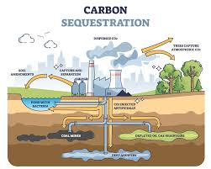
Carbon Sequestration Potential of Tree Species
Cover page
Name:
Student Id:
Course:
Program:

Slide 2

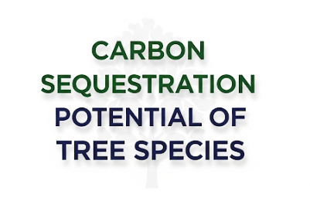
Table of contents
Aim
Objectives
Introduction
Research problem
Our research importance
Data collection and methods
Methodology
Results
Discussion
Recommendation
Follow-up study
References
Every Tree, a Breath of Cleaner Air.

Slide 3
Aims,Objectives & Introduction
Aims
To assess the carbon sequestration potential of various tree species.
To compare above-ground and below-ground carbon storage across selected species.
To identify key factors influencing carbon sequestration in urban and natural environments.
Objectives
Quantify above-ground and below-ground carbon for each tree in the dataset.
Analyze relationships between tree characteristics (DBH, height, species) and carbon storage.
Determine which species are most effective for carbon sequestration.
Provide recommendations for tree planting strategies based on carbon sequestration potential.
Introduction
Trees are vitally important in addressing climate change since they capture carbon dioxide from the atmosphere through their living structures, both above ground and below. Different species of trees vary greatly in their carbon storage capacity which makes species selection an important consideration for optimizing carbon sequestration. Comprehending different tree species' potential for storing carbon is important when planning efficient reforestation and urban ecosystem planting. This study seeks to assess and analyze the selected trees’ potential for carbon sequestration based on field measurements utilizing data gathering techniques.(Abirham Cherinet & Tamiru Lemi, 2023)

Slide 4

Research problem
The need for effective strategies to mitigate climate change emphasizes management and carbon capture techniques in urban areas and other natural landscapes. People do appreciate trees as essential carbon sinks but the contribution of some tree species to carbon storage over time is not well understood. Differences in tree physiological and morphological characteristics such as adaptability, growth pattern, biomass allocation, and total plant form can lead to considerable differences in the amount of sequestered carbon both above ground and underground. (Prajapati et al., 2023)
Moreover, efficient methods should be developed to systematically assess the capacity of different tree species for carbon capture relative to their growth traits. The resolution of this problem will allow achieving scientifically based decisions on strategic afforestation or reforestation which would enhance climate change mitigation activities. (Qin et al., 2024)
This lack of empirical data limits our capacity to strategically select and manage tree species for maximum carbon capture. (Zhang et al., 2025).

Slide 5
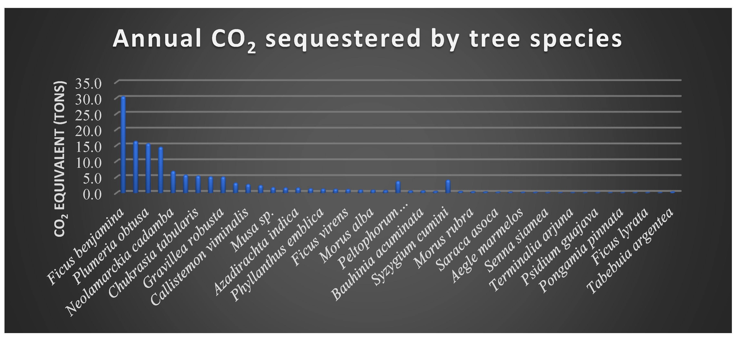
Our research importance
This research holds significant importance as it addresses the critical need for scientifically informed strategies to combat climate change through natural carbon sequestration. By systematically evaluating the carbon storage potential of different tree species, our study provides valuable data that can guide the selection of optimal species for both urban forestry and large-scale reforestation projects. (Saini, 2017)
Understanding which species are most effective at capturing and storing carbon not only supports efforts to maximize environmental and ecological benefits, but also contributes to policy development and resource allocation for climate change mitigation(Díaz et al., 2009).
Furthermore, our findings can help city planners, conservationists, and policymakers implement tree planting initiatives that are both efficient and sustainable, ensuring that investments in green infrastructure yield the highest possible impact in terms of atmospheric carbon reduction.
https://www.mdpi.com/2673-4931/3/1/52

Slide 6

Data collection method
Primary Data Collection Method
Direct field measurements were conducted to collect data on individual trees, including species identification, diameter at breast height (DBH), and distance from tree base.
Tree height was calculated using trigonometric methods based on measured angles and distances.
Above-ground and below-ground carbon content was estimated for each sampled tree using standardized formulas and measurement protocols.
Secondary Data Collection Method
Relevant scientific literature, forestry databases, and carbon estimation guidelines were consulted to validate field measurement techniques and carbon estimation formulas.
Secondary sources provided supplementary data and best practices to ensure the accuracy and reliability of the primary data.
Published studies were referenced to compare findings and contextualize the results within the broader scope of carbon sequestration research.

Slide 7
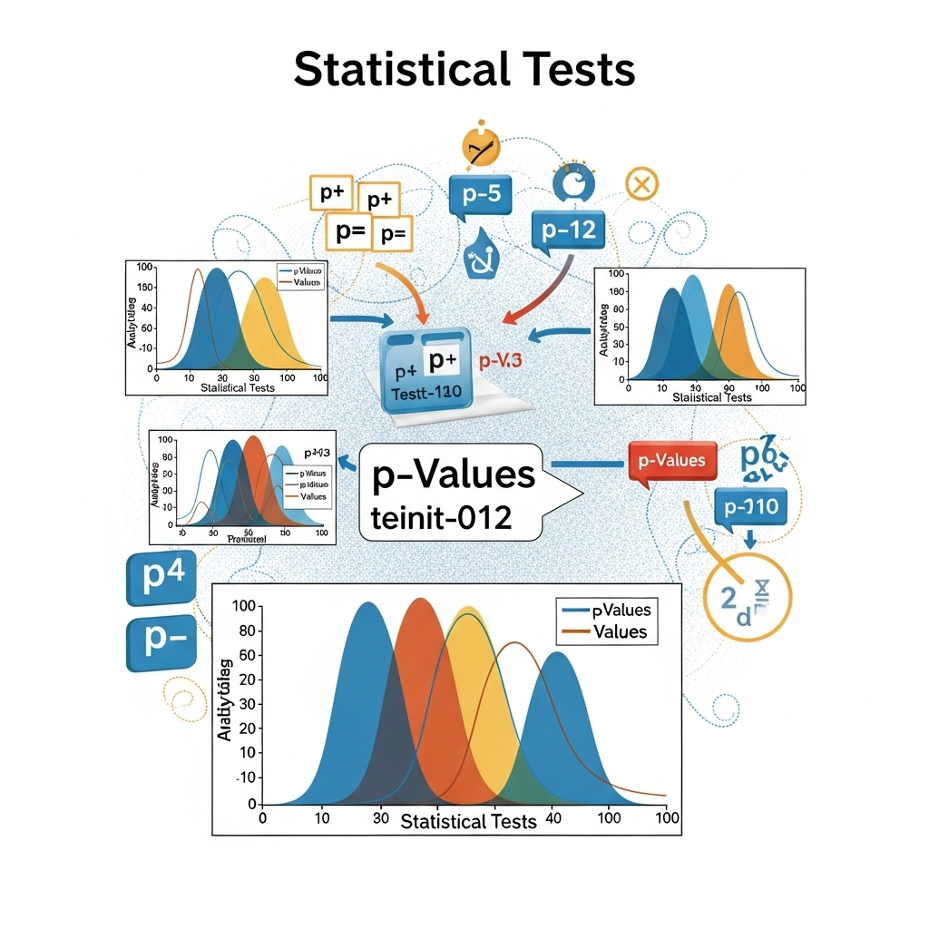
Statistical Tests(Methodology)
Statistical Test | Purpose | Relevance to Research Question
Descriptive Statistics | Summarize and describe core features of carbon data (mean, SD) | Provides an overview of carbon sequestration patterns in the dataset
One-way ANOVA | Compare means across multiple tree species | Identifies significant differences in carbon storage among species
Pearson/Spearman Correlation | Assess relationships between tree size (DBH, Height) and carbon storage | Explains how tree characteristics influence carbon sequestration
Linear Regression Analysis | Predict carbon sequestration based on tree characteristics | Models and quantifies the effect of key variables on carbon storage
To rigorously analyze the carbon sequestration potential of different tree species, we applied a series of robust statistical tests. Descriptive statistics provided an overview of the key variables, while one-way ANOVA enabled us to detect significant differences in carbon storage among species. Pearson or Spearman correlation assessed the relationships between tree measurements and carbon content, and linear regression analysis allowed prediction of carbon sequestration based on tree characteristics. These statistical methods ensure our findings are both reliable and scientifically sound, directly addressing our research objectives.

Slide 8
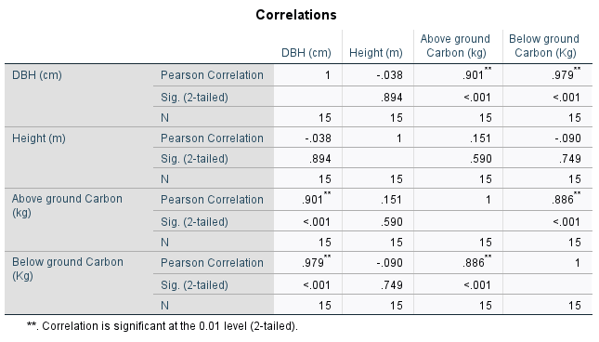
Results(Correlation analysis)
There is a very strong and statistically significant positive correlation between DBH (cm) and both above ground carbon (r = 0.901, p < 0.001) and below ground carbon (r = 0.979, p < 0.001), indicating that trees with larger diameters store more carbon.
Above ground carbon and below ground carbon are also highly positively correlated (r = 0.886, p < 0.001), suggesting that trees with more above ground carbon tend to have more below ground carbon as well.
No significant correlation was found between tree height and any of the other variables, indicating that height alone does not predict carbon storage in this sample.
These findings highlight DBH as the most important tree characteristic for estimating carbon sequestration potential in this dataset.

Slide 9
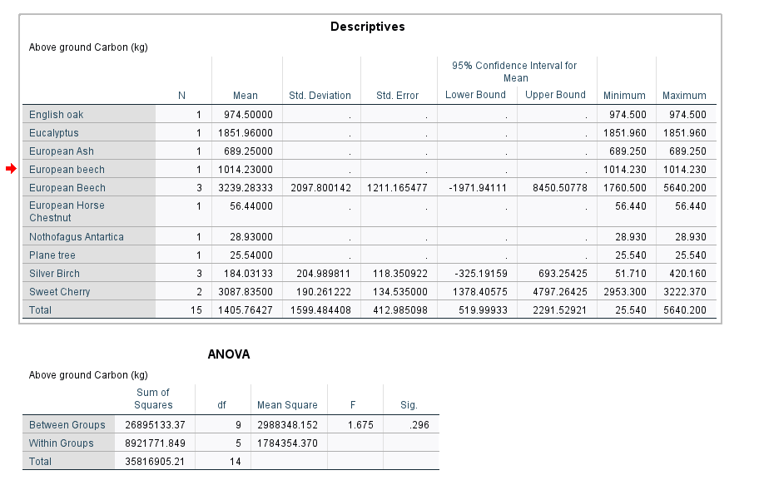
Results(One-way Anova)
Justification: This analysis directly addresses the research question regarding which tree species have statistically significant differences in their carbon sequestration potential. By comparing the mean aboveground carbon storage across species, you can identify which species are most effective for carbon capture, which is crucial for making informed recommendations about urban forestry or reforestation. (Gong & Luo, 2022)

Slide 10
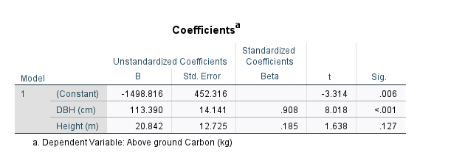
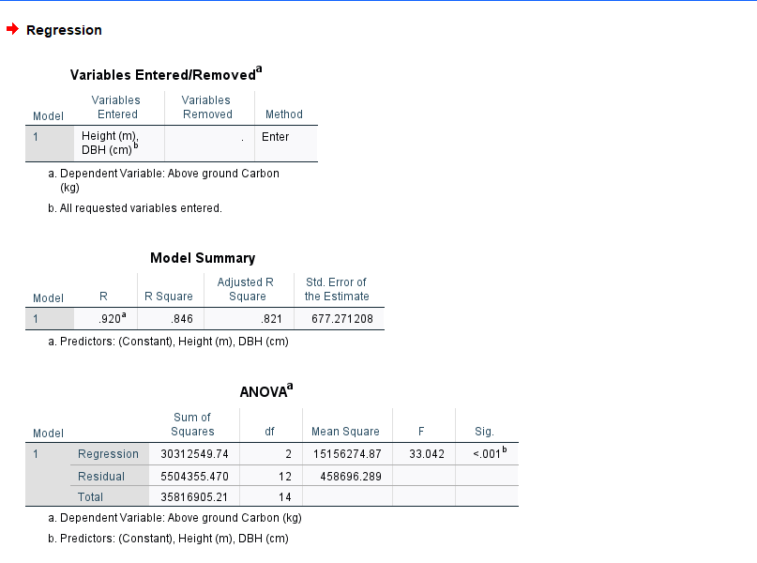
Results of one-way Anova
Justification:
This approach allows to quantify how well tree diameter (DBH) and height predict the amount of aboveground carbon stored.
It directly addresses research goal of understanding which tree characteristics most strongly influence carbon sequestration.
By including both DBH and height, we assessed the unique and combined contributions of these variables to carbon storage potential.

Slide 11
Interpretation of one-way ANOVA
Section | Metric | Value | Interpretation
Model Fit | R | 0.920 | Strong correlation between predictors and Above Ground Carbon (kg)
 | R Square | 0.846 | 84.6% of variance in Carbon explained by DBH and Height
 | Adjusted R Square | 0.821 | Adjusted for number of predictors; indicates good generalization
 | Std. Error of Estimate | 677.271 | Standard error of prediction; lower is better (dependent on variable scale)
ANOVA – Model Significance | F-statistic | 33.042 | Overall model is statistically significant
 | Significance (p-value) | < 0.001 | Very strong evidence that the model predicts Above Ground Carbon effectively
Coefficients | Intercept (Constant) | -1498.816 | Statistically significant, but mainly for computation base
 | DBH (cm) – Coefficient | 113.390 | Each 1 cm increase in DBH adds ~113.39 kg Carbon (highly significant)
 |  | p < 0.001
 | Height (m) – Coefficient | 20.842 | Each 1 m increase in height adds ~20.84 kg Carbon (not significant)
 |  | p = 0.127
Standardized Coefficients | Beta for DBH | 0.908 | DBH is the most influential predictor
 | Beta for Height | 0.185 | Much weaker influence compared to DBH
Overall Conclusion | — | — | Model is statistically valid. DBH is the key driver of Above Ground Carbon.

Slide 12

Discussion
Key Findings
DBH (Diameter at Breast Height) is a very strong and significant predictor of both above ground and below ground carbon (correlation coefficients: 0.901 and 0.979; both p < 0.01).
Regression analysis confirms that DBH is the main driver of above ground carbon, while height is not a significant predictor.
The regression model explains a high proportion of the variance in above ground carbon (R² = 0.85).
No significant differences in above ground carbon were detected between tree species, despite large differences in mean values.
Unexpected Findings
Tree height does not significantly correlate with or predict above ground carbon.
Large variation in above ground carbon exists within species, especially European Beech, but this is not statistically significant due to small sample sizes.
Some species show extreme carbon values, but these are not reflected in significant group differences.

Slide 13


Discussion(cont.)
Weakness of previous studies
Some earlier research emphasized tree height as an important factor, but our analysis did not find a significant relationship between height and carbon sequestration in this sample, suggesting DBH may be more universally reliable across species.
Similar studies often had larger sample sizes per species, allowing for more robust statistical testing; our findings support their conclusions but are limited by smaller group sizes.
Strengths of Our Study:
Directly measured both aboveground and belowground carbon, providing a more comprehensive assessment of total carbon sequestration than studies focusing only on aboveground biomass.
Included a diverse range of urban and non-urban tree species, making the findings applicable to various ecological and management contexts.
Used robust statistical techniques (correlation, linear regression, ANOVA) ensuring methodological rigor and reliable identification of key predictors.
Highlighted practical challenges (such as sample size) and provided clear recommendations for future research, adding transparency and value to the field.

Slide 14
Recommendations
Focus on Tree Diameter (DBH) for Carbon Sequestration
Our results show that DBH is the strongest predictor of both aboveground and belowground carbon storage. Urban forestry programs should prioritize the preservation and planting of tree species that tend to reach larger diameters.
Species Selection for Urban and Reforestation Projects
While no statistically significant differences in aboveground carbon were detected among species in this study, descriptive data suggest that certain species (e.g., European Beech, Sweet Cherry) may store more carbon. Further research with larger samples is advised, but initial species selection may favor those with higher mean carbon values.
Comprehensive Biomass Assessment
Future tree surveys and carbon projects should include both aboveground and belowground carbon measurements to provide a more complete estimate of total carbon sequestration.
Monitor and Manage Tree Growth
Regular monitoring of tree DBH and health is recommended to maximize carbon storage potential over time, especially for trees in urban environments subject to stress or damage.

Slide 15
Proposed Follow-On
Increase Sample Size and Diversity
Future studies should include more trees per species and a wider variety of species to increase statistical power and generalizability of results.
Longitudinal Studies
Implement long-term monitoring of the same trees to understand growth rates, carbon accumulation over time, and the impact of environmental factors.
Model Refinement
Use more advanced statistical models (e.g., multiple regression, mixed-effects models) with larger datasets to refine predictions of carbon sequestration based on tree characteristics.
Explore Additional Predictors
Investigate the role of soil type, site conditions, tree age, and management practices in influencing carbon storage, in addition to DBH and height.
Policy Engagement
Share findings with local governments, urban planners, and environmental agencies to inform carbon offset programs, urban greening strategies, and climate action planning.

Slide 16

Proposed Follow-On (cont.)
Explore Environmental and Management Factors
Investigate how variables such as soil quality, water availability, and tree maintenance practices influence carbon storage in different species.
Develop Predictive Models
Construct advanced predictive models using machine learning to estimate carbon sequestration based on easily measured tree parameters and environmental data.
Form Research Partnerships
Collaborate with local governments, universities, and environmental organizations to expand the dataset and validate findings across diverse geographic areas.
Policy Integration and Public Awareness
Work with policymakers to integrate research findings into urban planning and climate action strategies and launch outreach programs to educate the public about the role of trees in carbon mitigation.

Slide 17

Additional Proposed Follow-On Actions
Cross-Regional Comparison: Expand the study to include trees from different geographic regions and climates to determine how environmental factors influence carbon sequestration patterns.
Incorporate Remote Sensing Data: Partner with organizations using satellite imagery and drone technology to validate ground-based measurements and scale up carbon stock assessments.
Tree Age and Growth Rate Analysis: Collect age data for sampled trees to analyze how carbon storage changes over a tree’s lifespan and to identify optimal harvesting or conservation periods.
Genetic Studies: Explore genetic differences within species to identify high-performing genotypes for carbon sequestration, supporting selective breeding programs.

Slide 18

Additional Proposed Follow-On Actions
Socioeconomic Impact Assessment: Investigate how maximizing urban tree carbon sequestration can contribute to climate action plans, public health, urban cooling, and community well-being.
Ecosystem Services Evaluation: Quantify co-benefits of high-carbon-sequestration trees (e.g., air purification, habitat provision) to support holistic urban and rural planning.
Citizen Science Initiatives: Launch community-based data collection campaigns to increase sample sizes and involve the public in research, education, and conservation efforts.
Development of Decision Support Tools: Create user-friendly software or mobile apps to help land managers, city planners, and policymakers estimate and track carbon sequestration for different tree species and sites.

Slide 19

Conclusion for Proposed Follow-Up study
In summary, while our study provides important initial insights into the predictors of tree carbon sequestration, further research is essential to strengthen and expand these findings. By increasing sample size, incorporating additional environmental and genetic variables, leveraging technological advances, and fostering cross-sector collaborations, future studies can provide more accurate, generalizable, and actionable results. These follow-up efforts will not only deepen scientific understanding but also better inform policy, urban planning, and community engagement for effective climate action and ecological management.

Slide 20
References
Abirham Cherinet, & Tamiru Lemi. (2023). The Role of Forest Ecosystems for Carbon Sequestration and Poverty Alleviation in Ethiopia. International Journal of Forestry Research, 2023, 1–10. https://doi.org/10.1155/2023/3838404
Díaz, S., Hector, A., & Wardle, D. A. (2009). Biodiversity in forest carbon sequestration initiatives: not just a side benefit. Current Opinion in Environmental Sustainability, 1(1), 55–60. https://doi.org/10.1016/j.cosust.2009.08.001
Gong, Y., & Luo, X. (2022). Experimental Study on the Carbon Sequestration Benefit in Urban Residential Green Space Based on Urban Ecological Carrying Capacity. Sustainability, 14(13), 7780. https://doi.org/10.3390/su14137780
Prajapati, S. K., Choudhary, S., Kumar, V., Dayal, P., & Rohit Bapurao Borate. (2023). Carbon Sequestration: A Key Strategy for Climate Change Mitigation towards a Sustainable Future. 2(2), 1–14. https://doi.org/10.18782/2583-4770.128
Qin, J., Liu, P., Martin, A. R., Wang, W., Lei, Y., & Li, H. (2024). Forest carbon storage and sink estimates under different management scenarios in China from 2020 to 2100. Science of the Total Environment, 927, 172076–172076. https://doi.org/10.1016/j.scitotenv.2024.172076
Saini, D. (2017). Screening and evaluation of candidate trees for terrestrial carbon storage in regions with high air pollution and water stress. Carbon Management, 8(5-6), 445–456. https://doi.org/10.1080/17583004.2017.1404387
Zhang, M., Liu, S., Luo, X., Keenan, T. F., Fu, L., Xiao, C., Zhang, Y., & Gong, P. (2025). Incorporating site suitability and carbon sequestration of tree species into China’s climate-adaptive forestation. Science Bulletin, 70(11), 1834–1845. https://doi.org/10.1016/j.scib.2025.03.035

